Slide 1

Sequence motif analysis using Bio.motifs
Supervisor: DR . Sara Salah

Slide 2







Course Outline
Introduction
Motif objects
Creating a motif from instances
Creating a sequence logo
Reading motifs
Writing motifs
Comparing motifs
References

Slide 3

First Section
We will cover these definitions:
Motif
Sequence motifs
DNA sequence motif

Slide 4

Introduction
Motif A short (usually not more than 20 amino acids) conserved sequence of biological significance.
Motif are of two types (1) Sequence motifs and (2) structure motifs.
Motif discovery is the problem of finding recurring patterns in biological data. Patterns can be sequential, mainly when discovered in DNA sequences. They can also be structural (e.g., when discovering RNA motifs). Finding common structural patterns helps to gain a better understanding of the mechanism of action (e.g. post-transcriptional regulation). Unlike DNA motifs, which are sequentially conserved, RNA motifs exhibit conservation in structure, which may be common even if the sequences are different
Sequence motifs A sequence motif is a nucleotide or amino-acid sequence pattern that is widespread and has, or is conjectured to have, a biological significance. A protein sequence motif is an amino-acid sequence pattern found in similar proteins; change of a motif changes the corresponding biological function.

Slide 5
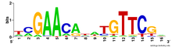
…
In biology, a sequence motif is a nucleotide or amino-acid sequence pattern that is widespread and usually assumed to be related to biological function of the macromolecule.
A DNA sequence motif represented as a sequence logo for the LexA-binding motif.

Slide 6
Motif objects
Since we are interested in motif analysis, we need to take a look at Motif objects in the first place. For that we need to import the Bio.motifs library:
>>> from Bio import motifs
and we can start creating our first motif objects. We can either create a Motif object from a list of instances of the motif, or we can obtain a Motif object by parsing a file from a motif database or motif finding software.

Slide 7
Creating a motif from instances
Suppose we have these instances of a DNA motif:
>>> from Bio.Seq import Seq
>>> instances = [Seq("TACAA"),
... Seq("TACGC"),
... Seq("TACAC"),
... Seq("TACCC"),
... Seq("AACCC"),
... Seq("AATGC"),
... Seq("AATGC"),
... ]

Slide 8
…
then we can create a Motif object as follows:
>>> m = motifs.create(instances)
The instances are saved in an attribute m.instances, which is essentially a Python list with some added functionality, as described below. Printing out the Motif object shows the instances from which it was constructed:
>>> print(m)
TACAA
TACGC
TACAC
TACCC
AACCC
AATGC
AATGC
<BLANKLINE>

Slide 9
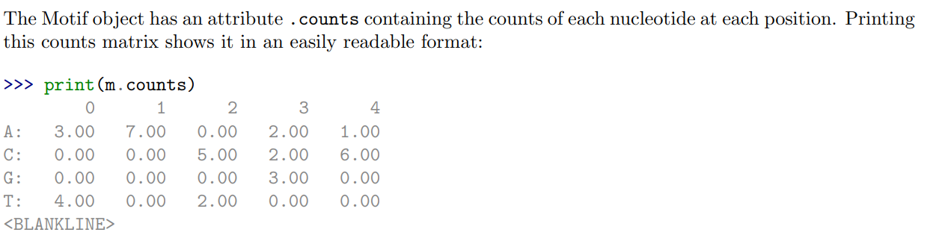
…
The length of the motif is defined as the sequence length, which should be the same for all instances: >>> len(m)
5

Slide 10
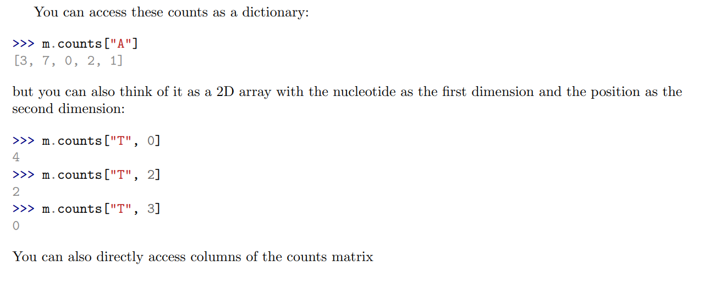
…

Slide 11
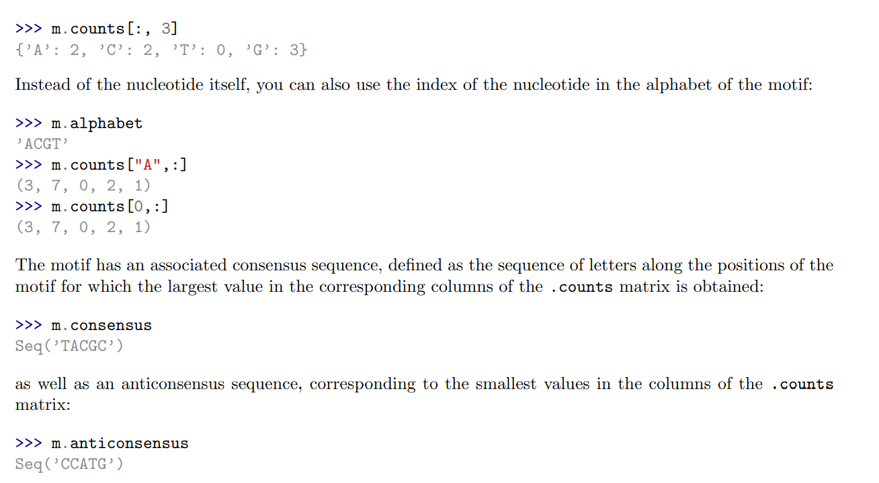
…

Slide 12
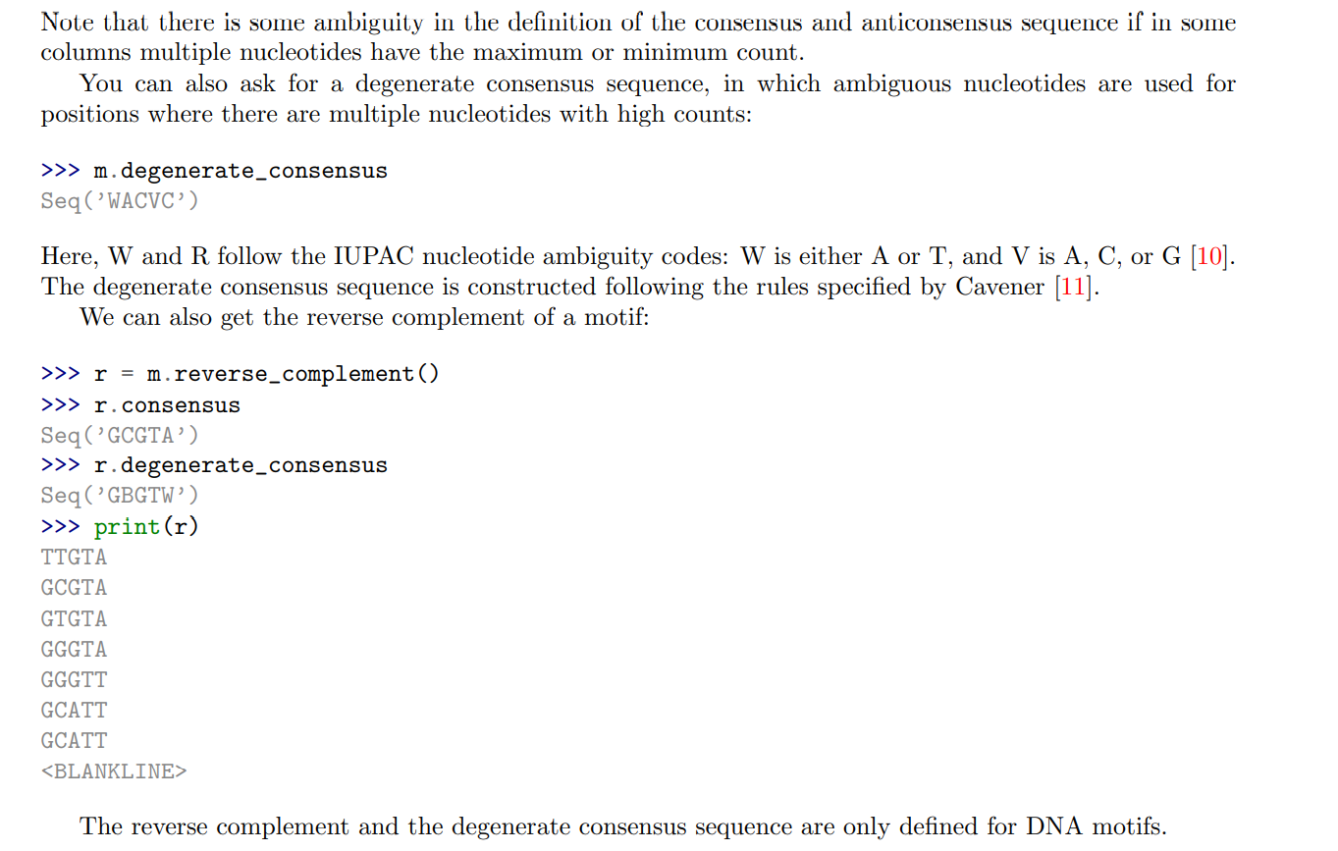
…

Slide 13
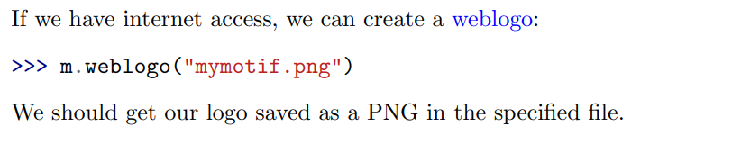
Creating a sequence logo

Slide 14
Reading motifs
Creating motifs from instances by hand is a bit boring, so it’s useful to have some I/O functions for reading and writing motifs. There are not any really well-established standards for storing motifs, but there are a couple of formats that are more used than others.

Slide 15
JASPAR
One of the most popular motif databases is JASPAR. In addition to the motif sequence information, the JASPAR database stores a lot of meta-information for each motif. The module Bio.motifs contains a specialized class jaspar.
The parts of the sequence in capital letters are the motif instances that were found to align to each other. We can create a Motif object from these instances as follows:
>>> from Bio import motifs
>>> with open("Arnt.sites") as handle:
... arnt = motifs.read(handle, "sites")
...

Slide 16
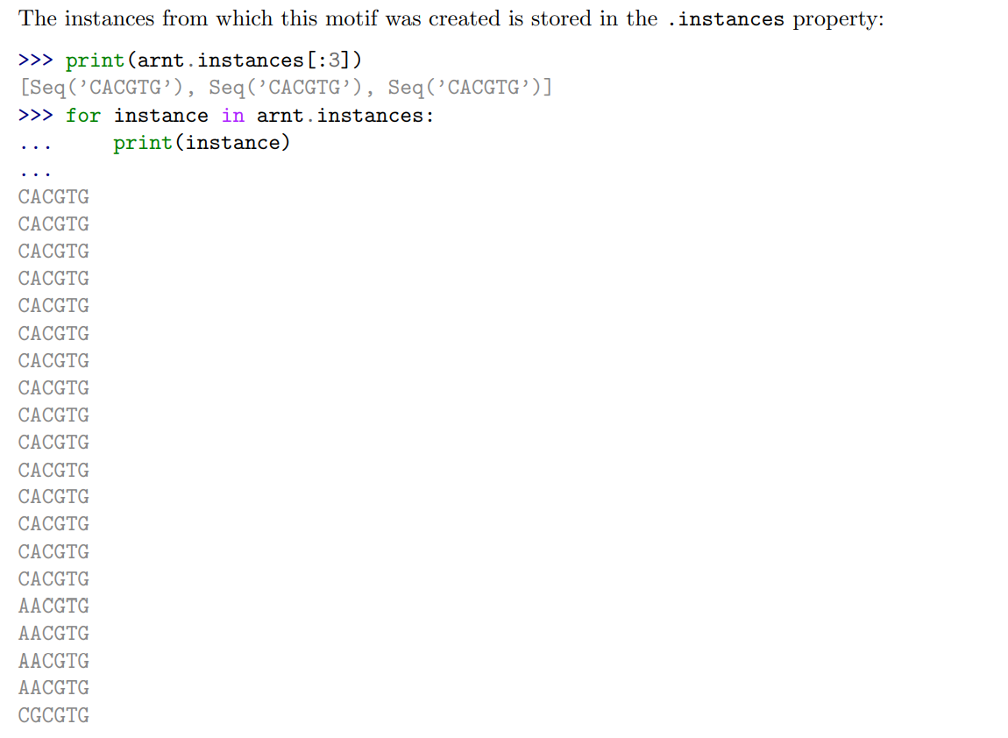

Slide 17
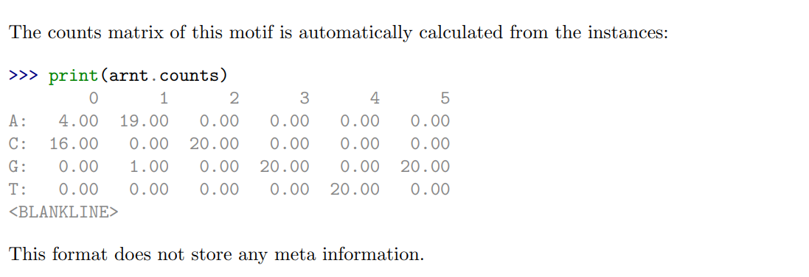
…

Slide 18
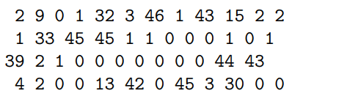
The JASPAR pfm format
JASPAR also makes motifs available directly as a count matrix, without the instances from which it was created. This pfm format only stores the counts matrix for a single motif. For example, this is the JASPAR file SRF.pfm containing the counts matrix for the human SRF transcription factor:

Slide 19
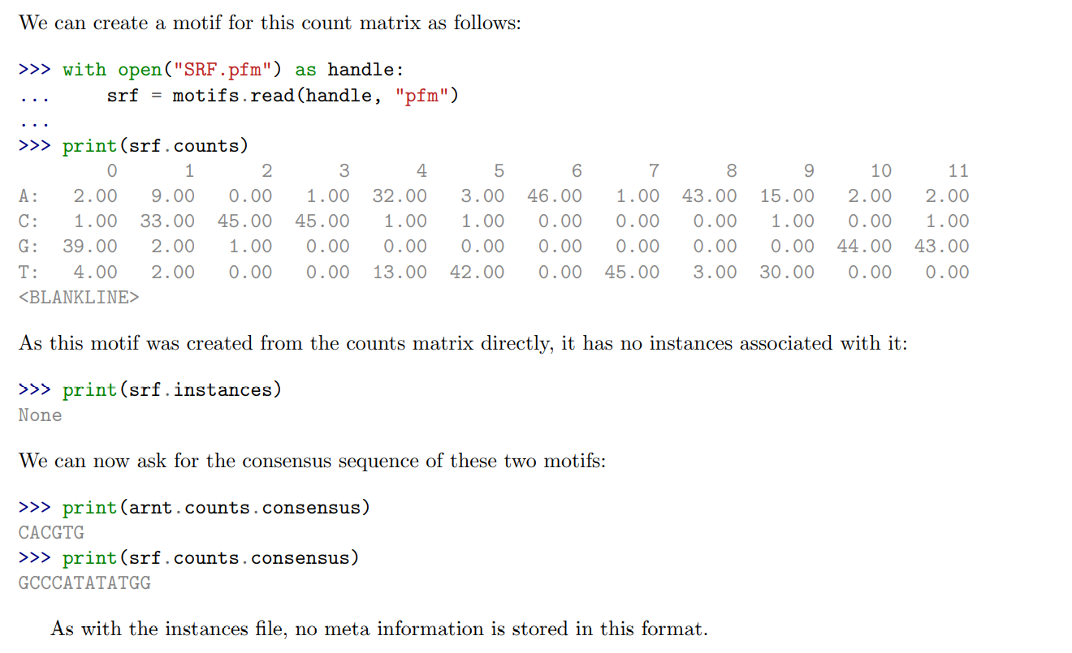

Slide 20
MEME
MEME [12] is a tool for discovering motifs in a group of related DNA or protein sequences. It takes as input a group of DNA or protein sequences and outputs as many motifs as requested. Therefore, in contrast to JASPAR files, MEME output files typically contain multiple motifs. This is an example. At the top of an output file generated by MEME shows some background information about the MEME and the version of MEME used:

Slide 21
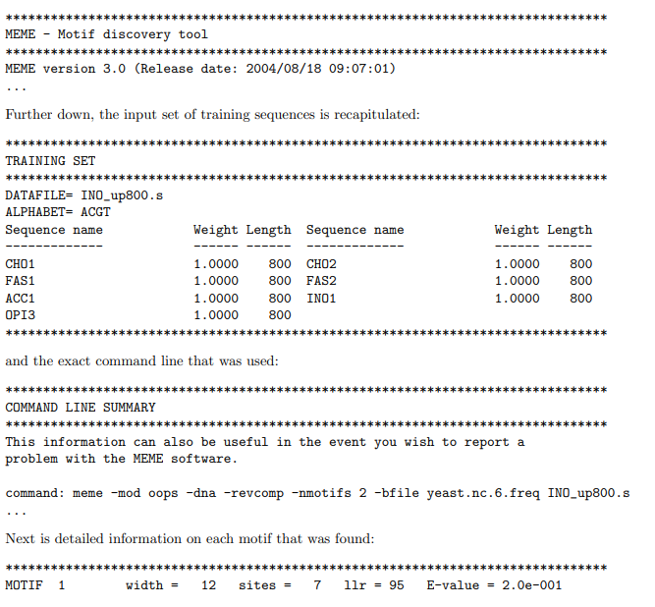

Slide 22
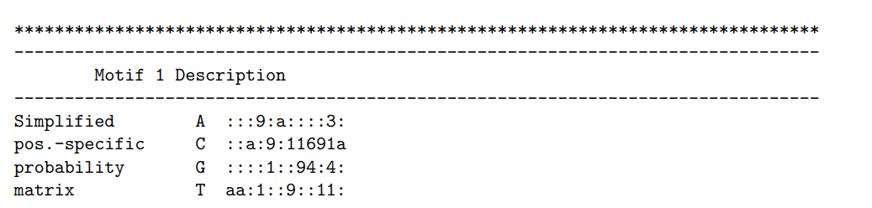
…

Slide 23
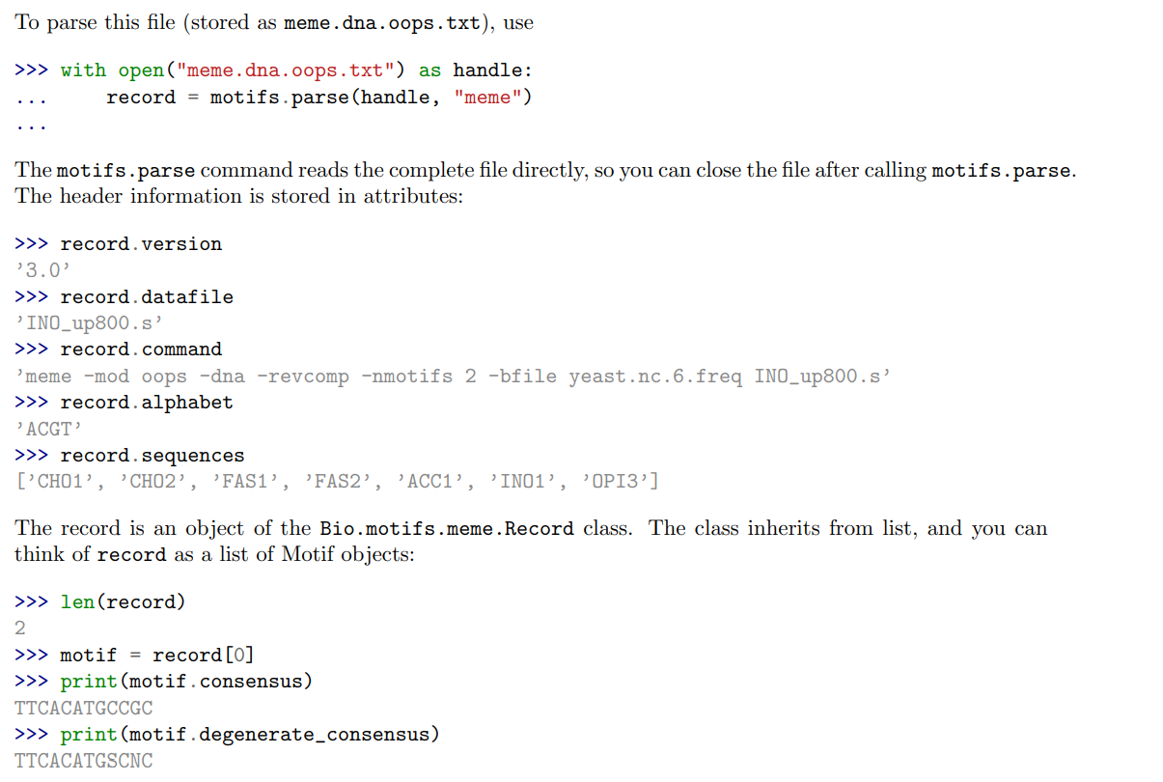

Slide 24
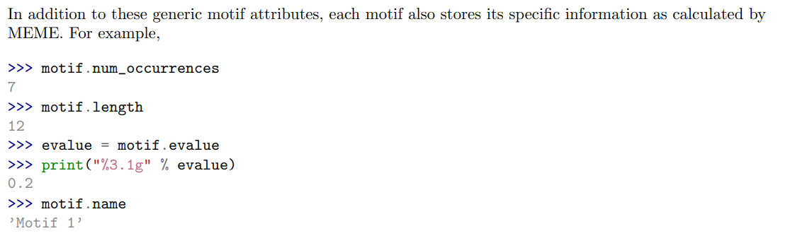
…

Slide 25
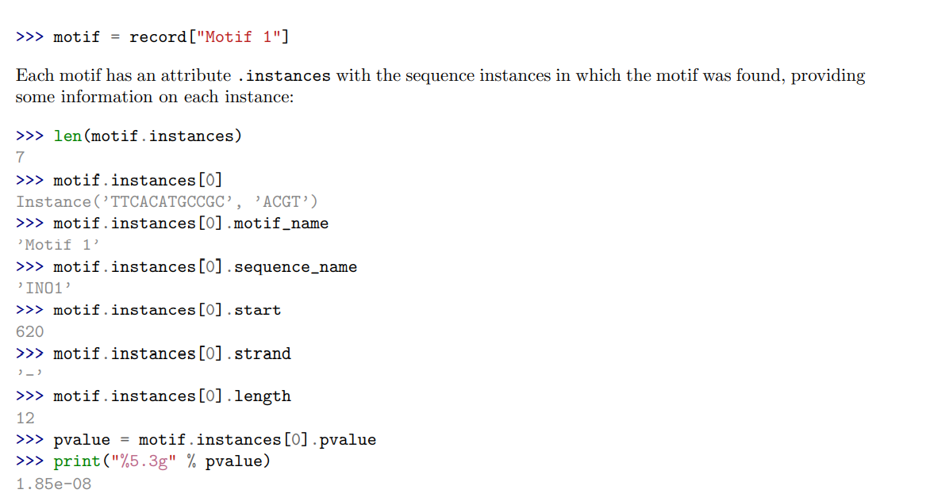
…
In addition to using an index into the record, as we did above, you can also find it by its name:

Slide 26
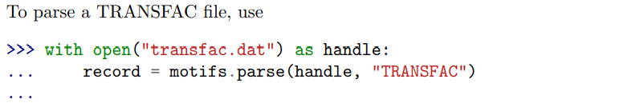
TRANSFAC
TRANSFAC is a manually curated database of transcription factors, together with their genomic binding sites and DNA binding profiles [33].

Slide 27

…
If any discrepancies between the file contents and the TRANSFAC file format are detected, a ValueError is raised. Note that you may encounter files that do not follow the TRANSFAC format strictly. For example, the number of spaces between columns may be different, or a tab may be used instead of spaces. Use strict=False to enable parsing such files without raising a ValueError:

Slide 28
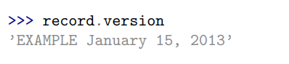
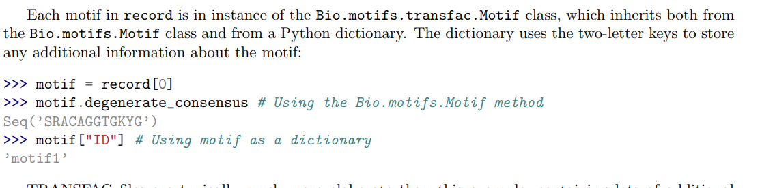
…

Slide 29
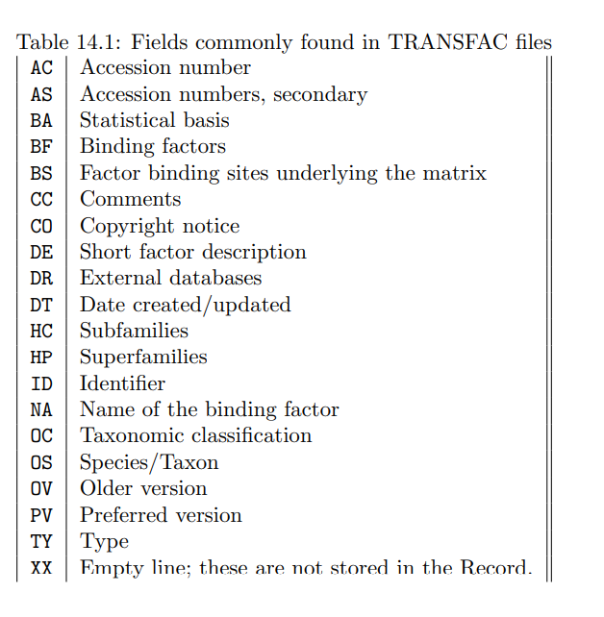
TRANSFAC files are typically much more elaborate than this example, containing lots of additional information about the motif.

Slide 30
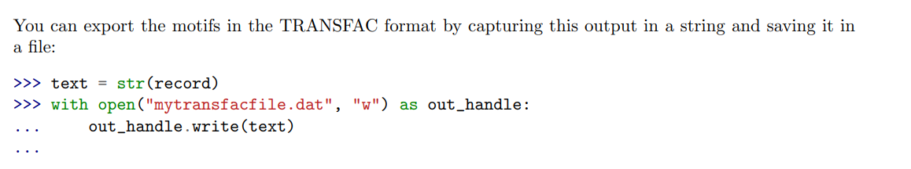
…

Slide 31
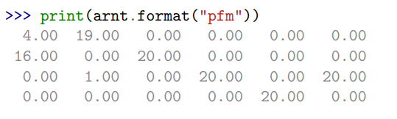
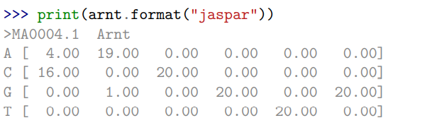
Writing motifs
We can use the format method to write the motif in the simple JASPAR pfm format:
Similarly, we can use format to write the motif in the JASPAR jaspar format:

Slide 32
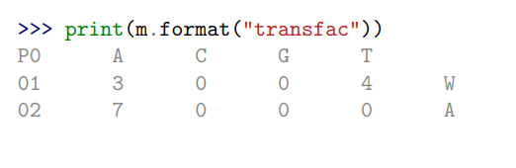
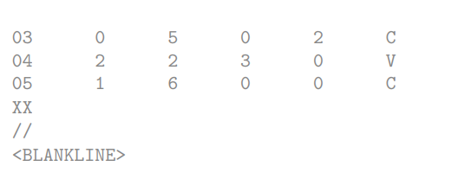
…
To write the motif in a TRANSFAC-like matrix format, use

Slide 33
Comparing motifs
Once we have more than one motif, we might want to compare them. Before we start comparing motifs, I should point out that motif boundaries are usually quite arbitrary. This means we often need to compare motifs of different lengths, so comparison needs to involve some kind of alignment. This means we have to take into account two things: • alignment of motifs • some function to compare aligned motifs

Slide 34
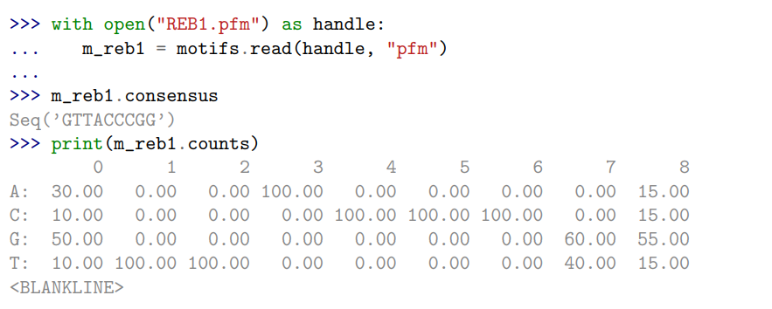
…
To align the motifs, we use ungapped alignment of PSSMs and substitute zeros for any missing columns at the beginning and end of the matrices. This means that effectively we are using the background distribution for columns missing from the PSSM.
To give an example, let us first load another motif, which is similar to our test motif m:

Slide 35
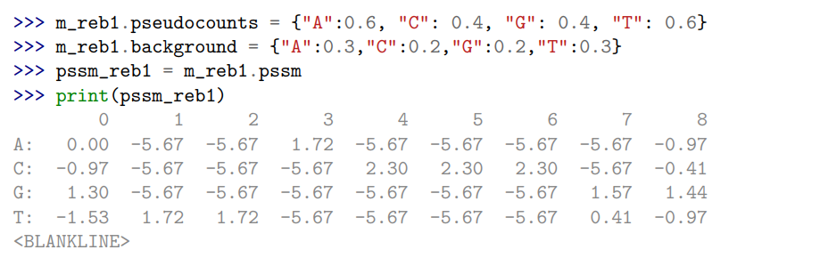
…
To make the motifs comparable, we choose the same values for the pseudo counts and the background distribution as our motif m:

Slide 36
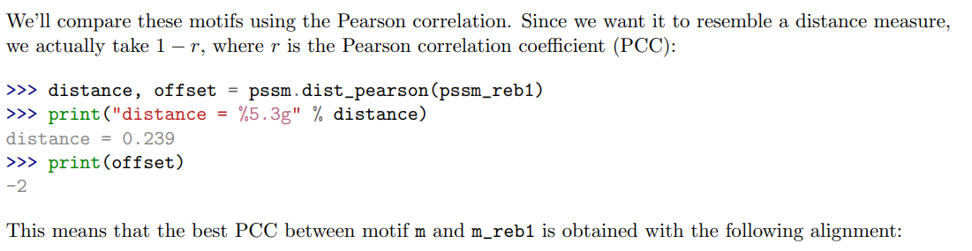
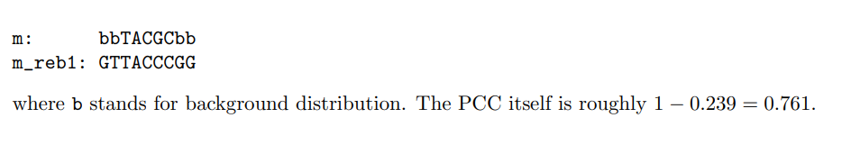
…

Slide 37
Meet our team
Maha Mahmoud Mohammed
Nourhan Mohamed Ali
Khloud Farouk Fouad
Team Leader
Team member
Team member
Hend Khaled Lotfy
Salma Ahmed Nady
Hala Khaled Mohamed
Team member
Team member
Team member

Slide 38
References
https://omicstutorials.com/motif-sequence-structure-motifs-bioinformatics-analysis/
2-Motif objects
1-Introduction
https://en.wikipedia.org/wiki/Sequence_motif
Biopython Tutorial and Cookbook

Slide 39

References …
Sequence motifs in Wikipedia, PWM in Wikipedia
3-Creating a motif from instances
4-Creating a sequence logo
5-Reading,Writing and Comparing motifs
Consensus sequence in Wikipedia, comparison of different motif finding programs

Slide 40
Thank you
Maha.20367810@compit.aun.edu.eg
Nourhanne.20367835@compit.aun.edu.eg
khloud.20367653@compit.aun.edu.eg
Hind.20367841@compit.aun.edu.eg
salma.20367693@compit.aun.edu.eg
hala.20367838@compit.aun.edu.eg

